Slide 1

Speeding up Secure Software Development
How to make security work at DevOps Delivery Speeds

Slide 2

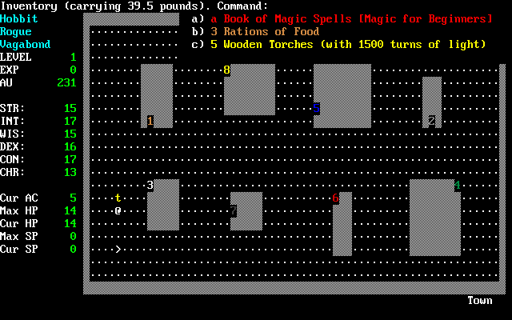



$ whoami
Ulisses Albuquerque Principal Security Consultant @ PC+S Group Agile/DevOps Advocate Hobbyist bitbanger and retrogamer
ulissesalbuquerque
urma
urma

Slide 3

What is the problem with “traditional” software security assurance?
Notes:
What is the problem we are trying to solve here..? History time – traditional security aligns with traditional software development, which is most commonly associated with waterfall methodologies

Slide 4
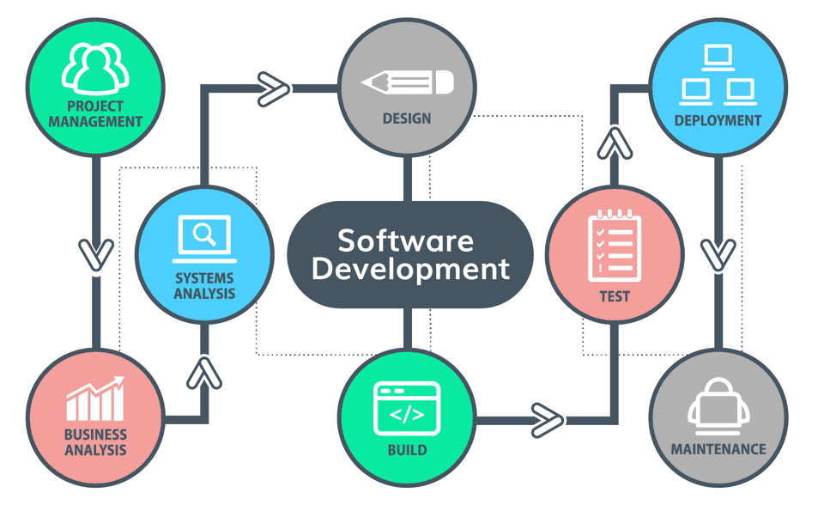
Software Development Lifecycle
Waterfall assumes linear flow
Documentation outputs for each stage used as inputs for the next stage
Security verification (typically) happens at operational handover
Notes:
In theory, there is a linear flow from identifying a business demand, breaking it down into requirements, design a solution, implementing, testing and deploying it. Some companies still work this way today, but most of the problems which are well understood enough to work in a way where they can be fully described before the first line of code is written are either already solved or not worth solving. Tough luck.

Slide 5
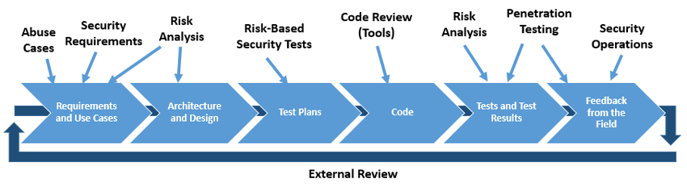
Security Touchpoints
Notes:
Application security, waterfall or not, defines what we should be doing at each stage of the SDLC in terms of security controls and outputs

Slide 6

Notes:
Waterfall works well for clients which don’t care about the details, but just want a solution delivered – they describe what is needed, get a quote (both time and cost) from vendor or development team and only worry about the software again when it’s ready to be used. Abstracting the details away also means other quality differentiators might not be evidenced, and thus cost becomes slightly more relevant.

Slide 7

Penetration Testing
Convenient one-size-fits-all solution for software security assurance in waterfall scenarios
Separation of duties
Easily outsourced
Hooks nicely to operational handover
Notes:
The go-to solution for security verification in most waterfall scenarios is pentesting – it ensures no (major) security vulnerabilities are present in the delivered solution

Slide 8

<insert pentest here>
Notes:
If we test the software (functional and non-functional requirements) before we deploy it, we can be sure no vulnerabilities (or at least none we care) will make their way into production environments

Slide 9

What are the issues with this approach?
Notes:
You might be thinking this looks perfectly legit and good, why is it a problem?

Slide 10

#1 Silo Culture
Notes:
Problem #1 is silo culture – there is very little incentive for knowledge sharing between development, operational and security teams when their activities are performed in isolation and done at specific points in time during the SDLC; this is made even worse by the idea that security audits are better handled by external teams rather than the team which built the solution and know all of its ins and outs

Slide 11
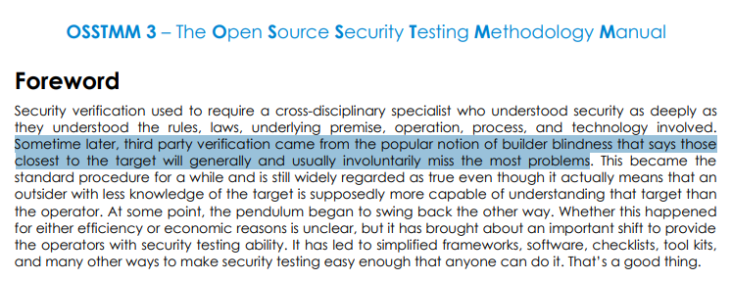
#1 Silo Culture
Notes:
Encourage collaboration and shared ownership of security for anything built by your organisation; if you get popped, it doesn’t matter who missed that vulnerability if everyone ends up without a job

Slide 12

OSSTMM TL;DR
Outsourcing security audits means not leveraging insider knowledge and sharing security skills; it is also condescending to development teams
Notes:
Foster a culture of sharing knowledge and blame; security failures in products are failures of the team involved in building it, regardless of them being in the business, development, architecture or operational side of things

Slide 13

#2 Reporting security Findings
Notes:
Security findings are typically reported in ways which feel very different than the average bug or feature request work items used by development teams; reports are also typically provided in formats meant for human consumption (e.g., PDF or Word documents), include generic remediation advice and focus on technical risk rather than

Slide 14
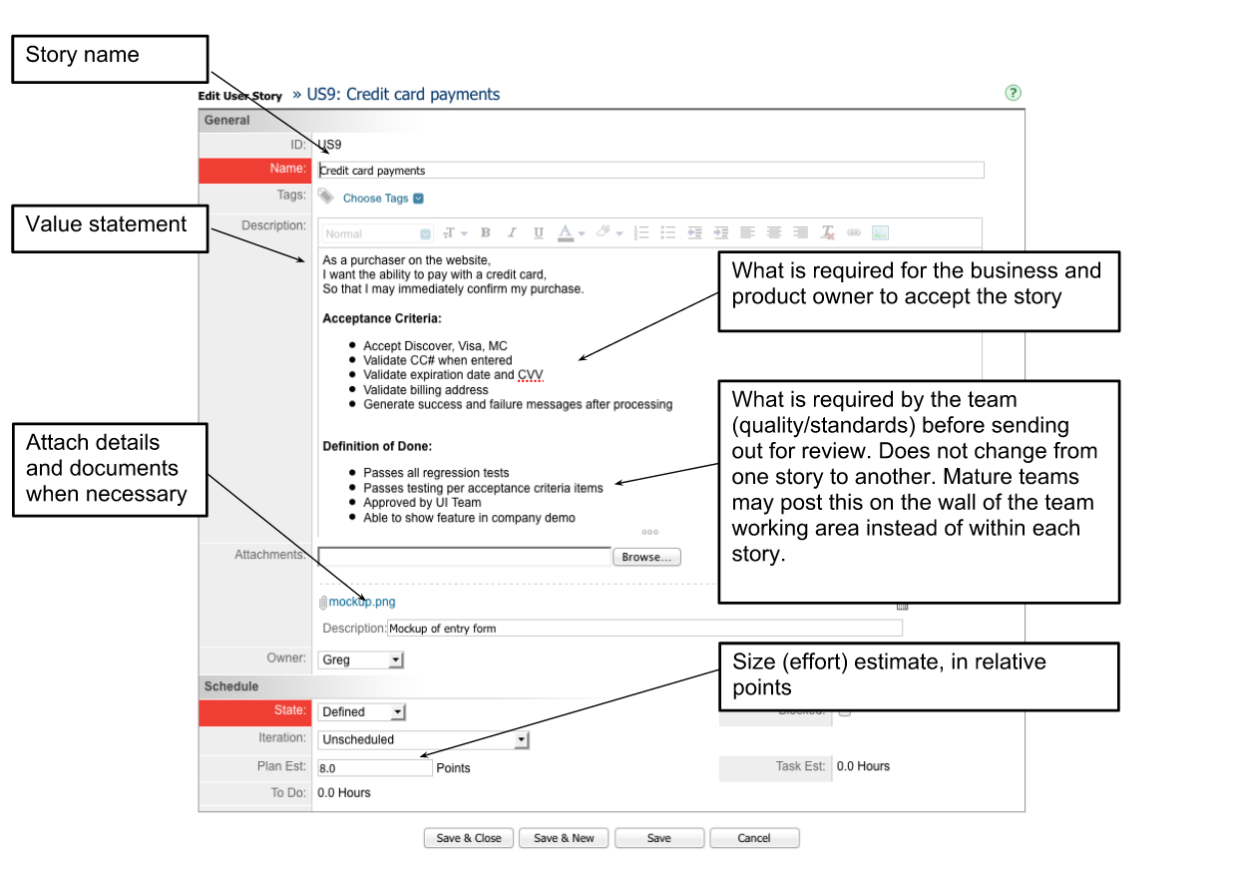
Typical User Story
Notes:
Lots of information which can be used to prioritise implementation of this feature – business value, acceptance criteria, effort estimates

Slide 15
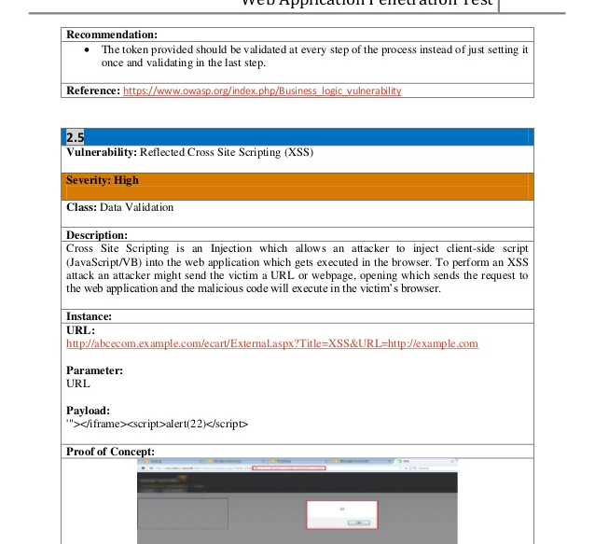
Typical pentest Finding
Notes:
Focus on what and how something was exploited, with description of technical impact; no mention of remediation effort, implementation-specific recommendations or acceptance criteria for the fix; translation of the issue as found by the pentester into the actual remediation actions is left to the development team

Slide 16

Wait a minute…
Notes:
New features are different from defects – that is true. However, defects identified in production (bugs) are different than those identified during testing, and because security testing is being done as part of the development lifecycle, it should be reported in a way that can be directly (or at least more easily) consumed by the development teams

Slide 17

#3 Tooling
Notes:
Tooling discrepancies is a direct consequence of #1 and impacts directly #2 – developers typically work with very different tool chains than security personnel, and often are not able to reproduce issues found in reports because of that.

Slide 18
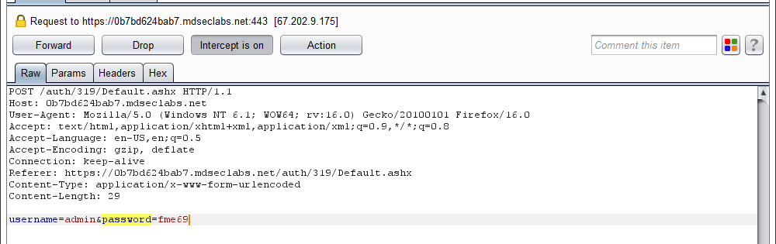
Developers do not have Burp
Notes:
Developers not using the same tools means they often cannot reproduce findings; combined with the lack of specific acceptance criteria for fixes this makes converging around what is acceptable fix for a security bug difficult

Slide 19
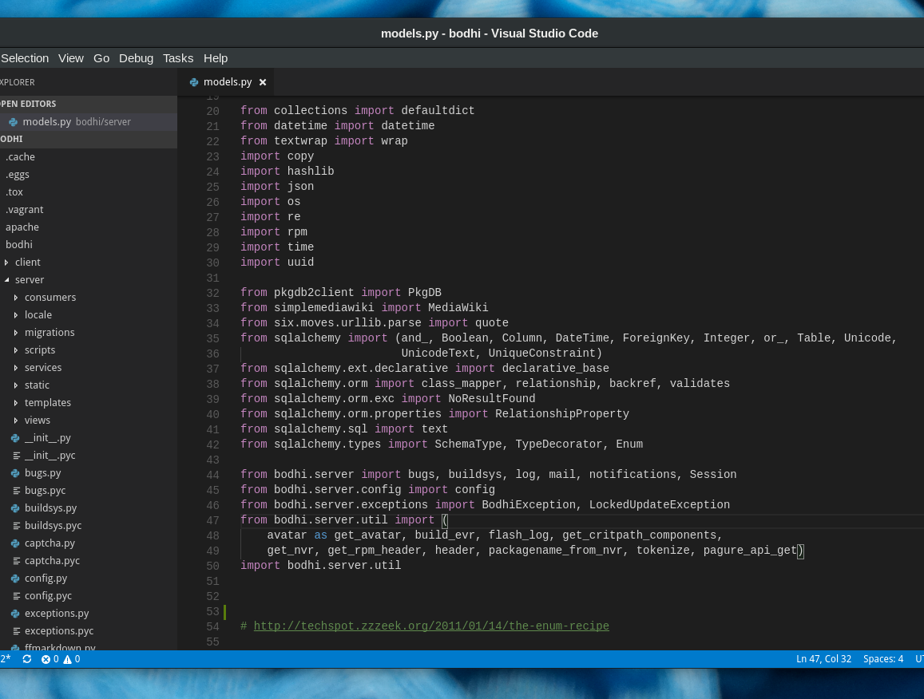
Security Staff (usually) does not have IDEs
Notes:
Security staff does not have access to dev tools, and often does not write code as part of their daily activities; this limits their ability to provide immediately actionable recommendations (e.g., sample fix code) in reports

Slide 20

Sure, it might not be ideal but it works…
Notes:
Even if you agree that the current solutions are not ideal, they might work well for you if your development teams are doing waterfall-ish work and delivering every 3-6 months or so. Despite all the flaws of the “traditional” model, there is still enough time between releases to compensate.

Slide 21


Slide 22

Notes:
However, once your company joins the DevOps bandwagon the previous problems become much bigger – people will want to move fast, and if your engagement model and reporting mechanisms are not able to keep up, they will work around you

Slide 23
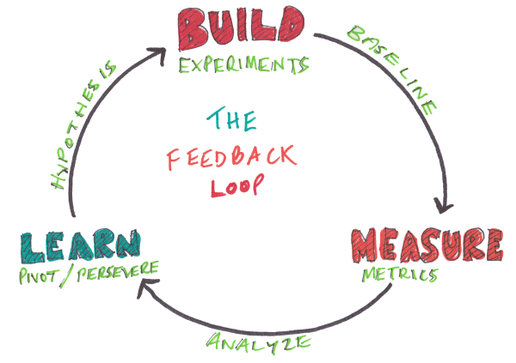

Slide 24
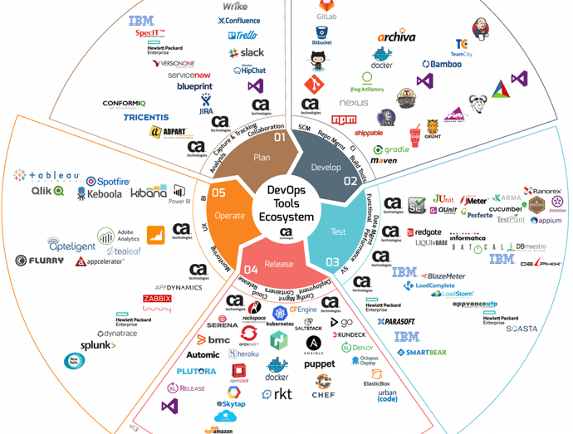
DevOps Stacks are ridiculously complex
Notes:
DevOps not only changes the SDLC pace and time to deliver, it also introduces a huge number of technologies and services which are needed to support those delivery speeds; some of those are variations on existing technologies and services which can still be handled by existing security tools, while others require totally different approaches

Slide 25
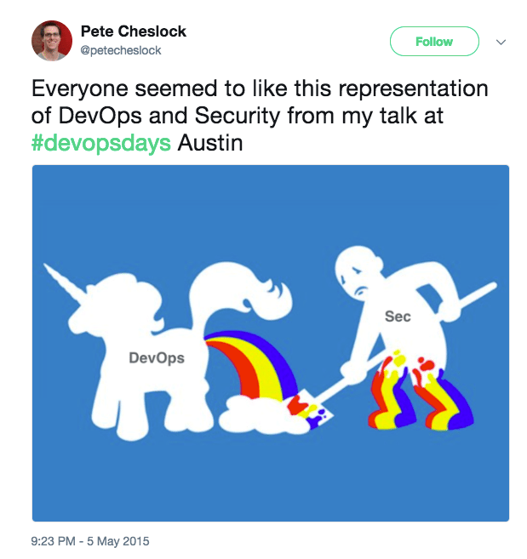
Notes:
There is a LOT of negativity around DevOps security; agile and DevOps are not inherently more insecure, but they do enable faster deliveries, and if your software is insecure it will make its way to production faster

Slide 26
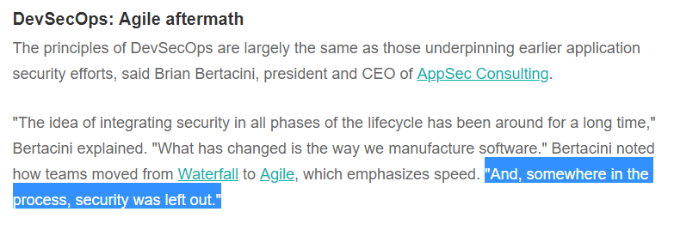
DevOps and security often Clash
Notes:
Security always aligned itself with operations; operations embraced the changes required to deliver software faster, but security for some reason failed to keep up

Slide 27
Re: Security Touchpoints
Anywhere from multiple times a day to once every 3-4 weeks
Notes:
Application security, waterfall or not, defines what we should be doing at each stage of the SDLC in terms of security controls and outputs; some of those controls won’t happen at EVERY release, but they must be performed in regular intervals, no matter how long those are, to ensure their efficacy is still adequate

Slide 28

DevOps Answer: Automation
Notes:
While some activities will not be done for every release, many of them can and should be done not only for every release but ideally for every single change introduced to the software

Slide 29

Build Pipelines and Continuous Integration
Notes:
The easiest place to add consistent, reliable and repeatable automated security tests to a devops project is the build pipeline or continuous integration platform; ideally, it should be triggered for every commit, and developers need to be immediately notified of security violations

Slide 30
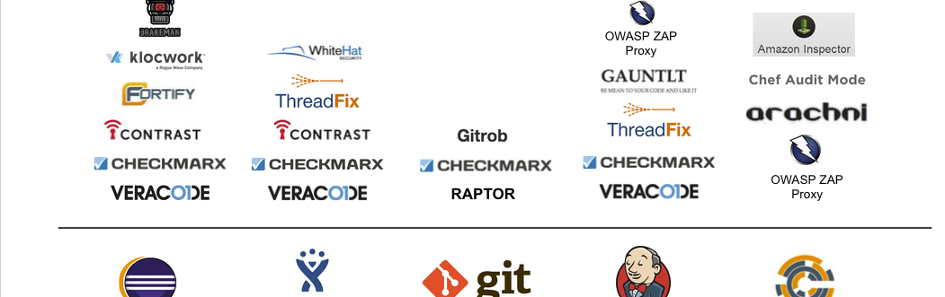
Which security controls to add to your pipeline?
Every vendor has a different answer
Notes:
There are a multitude of tools we can add to a pipeline; some of them will be more useful than others, and some of them will be more aligned with traditional software quality assurance controls than others; regardless, we should choose something the team is comfortable with and ensure it is properly maintained – security controls are not a fire-and-forget activity

Slide 31

#4 Tooling (revisited)
Notes:
Not all tools are created equal, and even some of the best security tools in the market were conceived for use cases which do not work well in unattended CI environments; Burp is a common one (it requires a UI and is meant to be used interactively), others have assumptions about how findings are going to be consumed (e.g., point-in-time snapshots versus historical trends), and others offer very little automation support (e.g., fire-and-forget tools which do not support per-scan parameters)

Slide 32

#4 Tooling (Revisited)
Enable developer self-service of security tooling
API-enabled
Machine-consumable reports (JSON, XML, CSV)
Historical data and trends (dashboards FTW)
Quality gates
Notes:
Providing tooling developers can hook to their CI environments means they can do the heavy lifting (with security’s support) and the “last mile plumbing” required to make security tools work with each specific project that needs to be scanned; it also means developers can the security tools as services rather than black boxes, and enables ownership of security controls rather than outsourcing the responsibility

Slide 33

#4 Tooling (Revisited)
New technologies and services require new security tools
Patching versus containers
Logging and auditing short-lived instances
Auto-scaling and monitoring
Serverless
Notes:
Some technologies and services used in DevOps are very different from the “old world” ones; containers, for instance, turn the problem of patching upside down by rebuilding images when something wrong happens, rather than

Slide 34
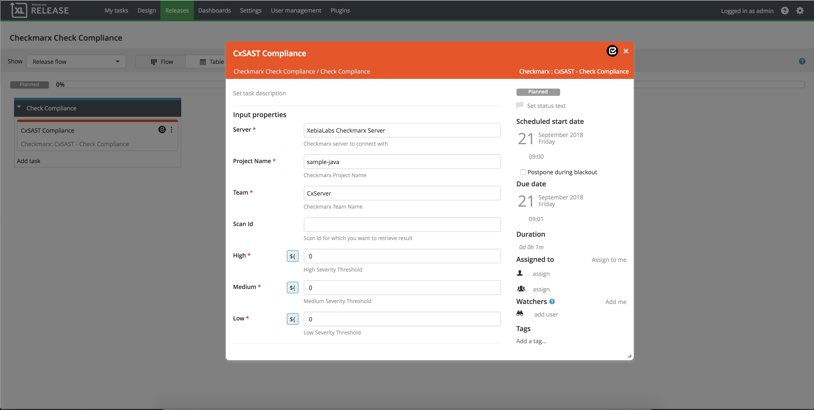
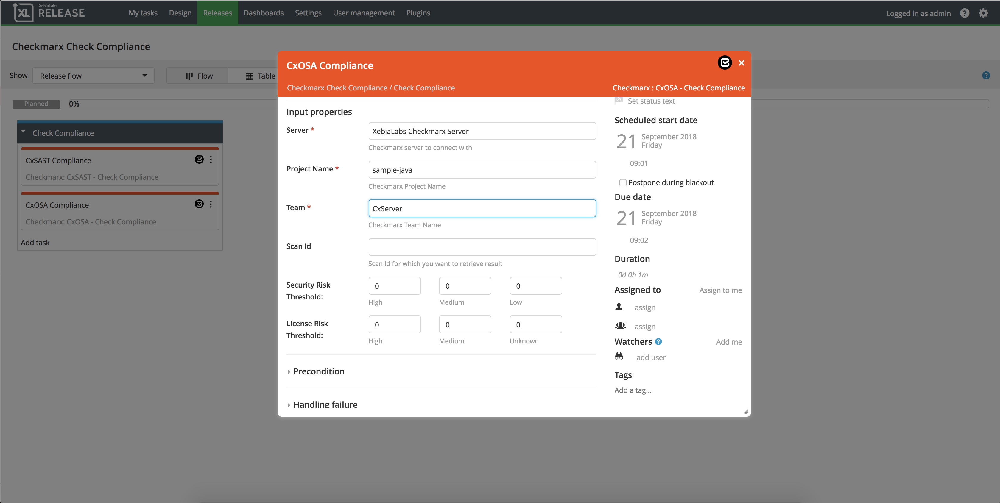
Integration with Continuous Integration Platforms
Notes:
You don’t want to use tools which cannot be automated, because this completely breaks the development flow for developers

Slide 35

#5 Separation of Duties
Notes:
Providing security tool self-service does not complete freedom for developers; security SMEs should still have control over policies

Slide 36
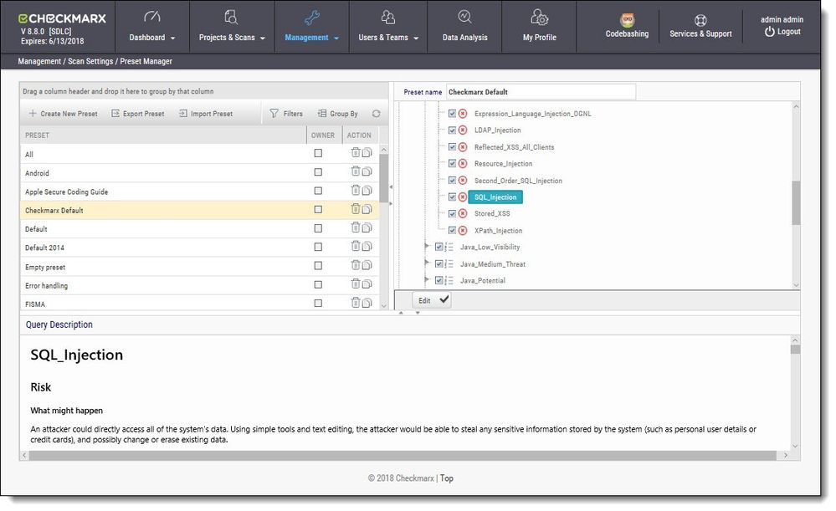
#5 Separation of Duties
Notes:
Developer profiles should now allow custom scan policies (unless there are specific needs); custom profiles should include technology-, team- and company-specific checks, which ideally should be derived from security assurance profiles associated with each application being developed

Slide 37
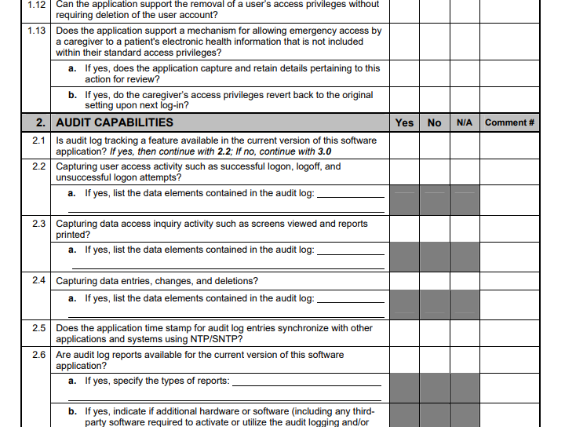
#5 Separation of Duties
Notes:
Use application security profiles to determine which controls and checks apply to each application; this way, security staff can focus on ensuring scan policies reflect the companies policies on security controls, while developers simply use the security tools to confirm their implementation meets the expectations; this also means that if new security threats emerge, policies can be updated without any action from the development teams – this can be a bit disruptive to team process (clean build today does not mean clean build tomorrow), but as long as everyone knows why and how it happens, it can enhance security posture immensely

Slide 38

#6 Security is not Special
Security is one of many metrics for software quality
It’s not even the most important one
Don’t make security harder by making it “special”
Input and output formats
Unified backlog

Slide 39

#6 Security is not Special
Provide Actionable information in an easy-to-consume format
If developers need to look at multiple places or translate things to know what needs to be done, it won’t get done or be lost in translation

Slide 40
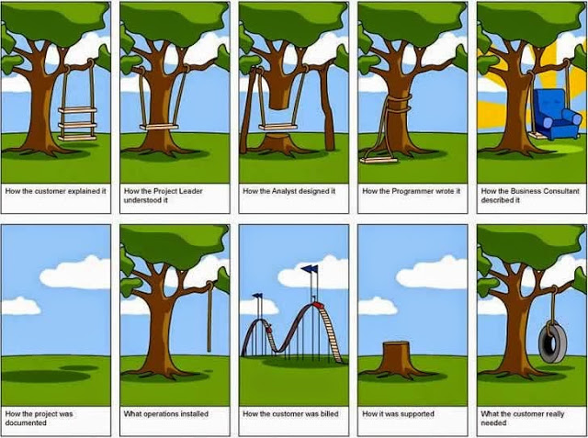

Slide 41
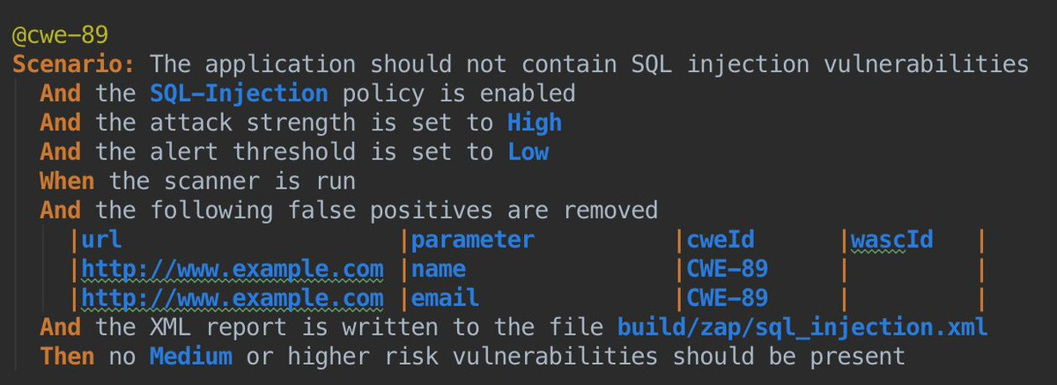
#7 Security Behaviour Driven Development
Notes:
BDD is a awesome, and while it will require some initial groundwork before becoming easy enough anyone can do it for a given project, it allows documentation AND verification of requirements, security or otherwise, in a trivial way; this is an area where security could learn a LOT from how traditional software testing has evolved

Slide 42

Notes:
By this point you probably see the pattern – even if there is a lot of technology involved, but the major issue is cultural, not technological; security at speeds means everyone understanding what needs to be done at SDLC stage, and verifying it’s being done properly using adequate controls

Slide 43
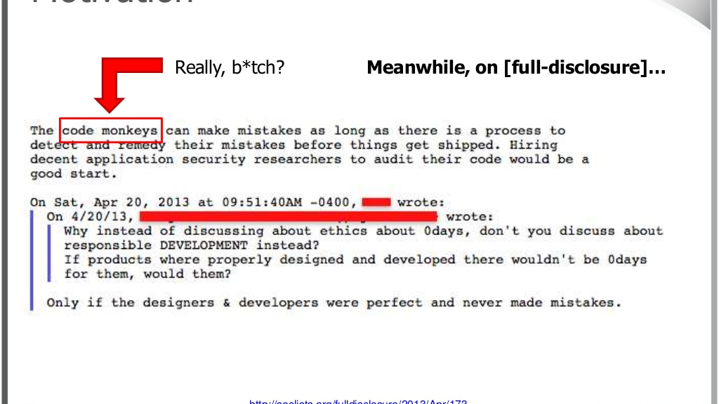
Notes:
This is from a talk I did in 2013 about security information in developer documentation for libraries and frameworks; it was incredibly lacking, and that is only focused on technical issues, not application- or business-specific security-relevant aspects of software development

Slide 44
Adversarial Modelling != Adversarial Relationship
Security assurance should not be an enemy of software development teams
Notes:
Traditional security controls are about adversarial modelling and challenging assumptions about what has been built, and there is absolutely no problem with that. However, that should translate to an adversarial relationship between security staff and software development teams; if a development team feels they are not getting any benefits from interacting with security, they will work around it, and that is trivial in the modern cloud-based environments

Slide 45
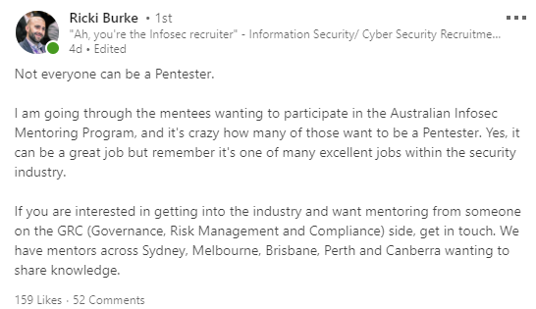
Notes:
There is more to security than adversarial testing, and even for the adversarial testers, information needs to be fed back to teams in a consistent, easy-to-use way

Slide 46
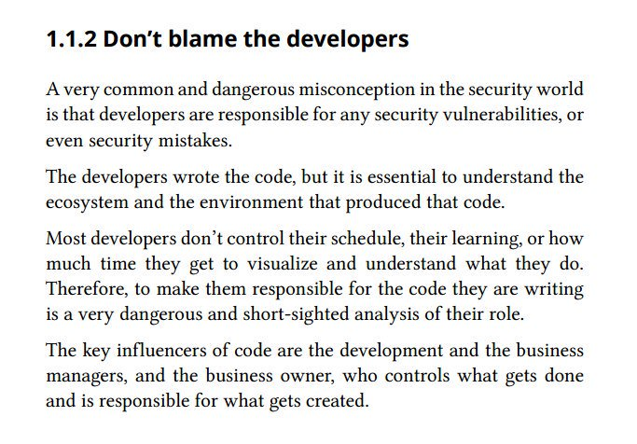
Notes:
Double-checking everything a developer does to prevent bugs from making their way into production is the wrong approach; it should be about giving the business, developers and security visibility on all concerns, what is being done to address those, and automating as much of that as possible so we don’t need to rely on humans repeating software verification, security or otherwise, over and over

Slide 47
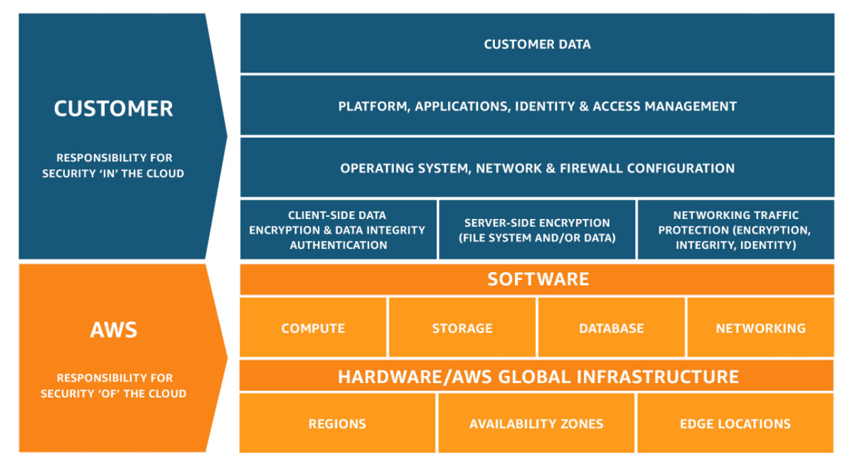
Notes:
Cloud vendors have learned long ago that shared accountability is the way to go – define responsibilities and expectations, but ENABLE everyone in the team to achieve those

Slide 48

Notes:
Collaboration works a LOT better than keeping those silo walls up; shared accountability is something that is already being pushed by cloud vendors, for example, and needs to be extended into development/security interactions inside organisations

Slide 49

Questions?
Notes:
Breaking

